Slide 1

Types of models in macroecology and biodiversity science
Petr Keil

Slide 2
Statistical vs mechanistic models

Slide 3
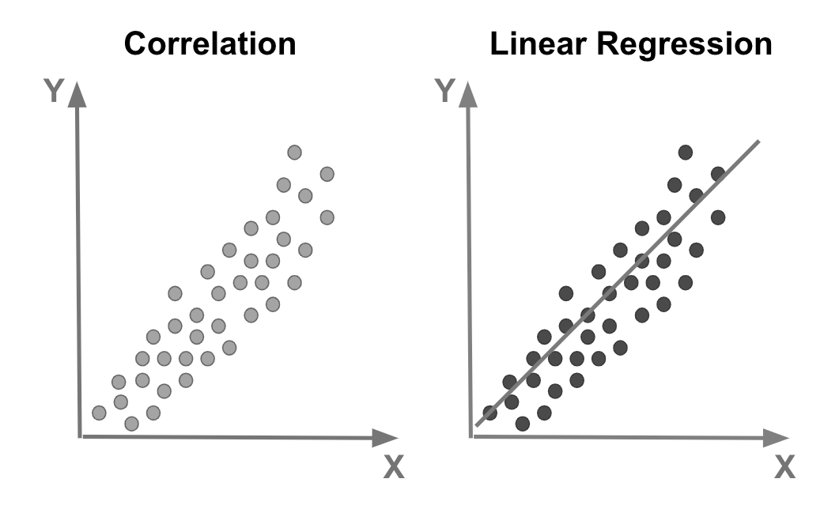
Statistical models
C
Pearson correlation (no model)
r = 0.8
Linear Regression (an actual statistical model)
Y = a + bX + e
e ~ Normal(0, SD)
Statistical models are functions (“smoothers”) that we fit to the data, together with density functions describing the residuals.

Slide 4
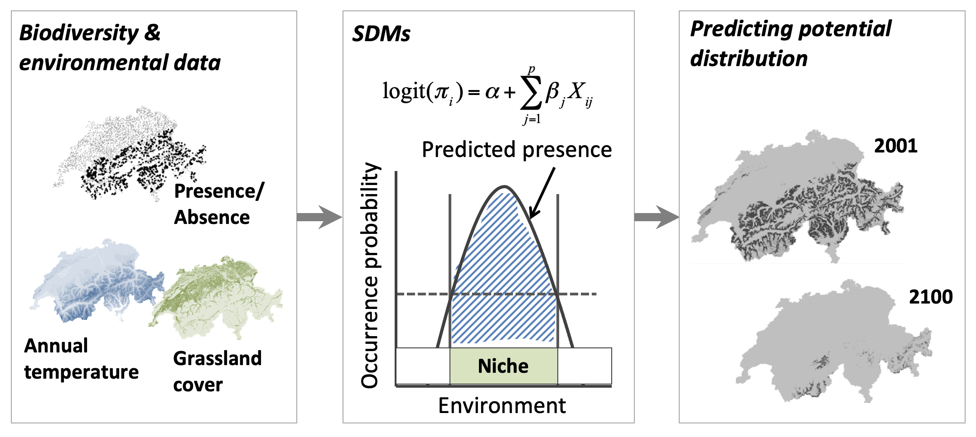
Example of statistical models: Species Distribution Models (SDMs)
1
Presence/absence
0
Annual temperature
Part of the scheme by Damaris Zurell: https://damariszurell.github.io/SDM-Intro/

Slide 5
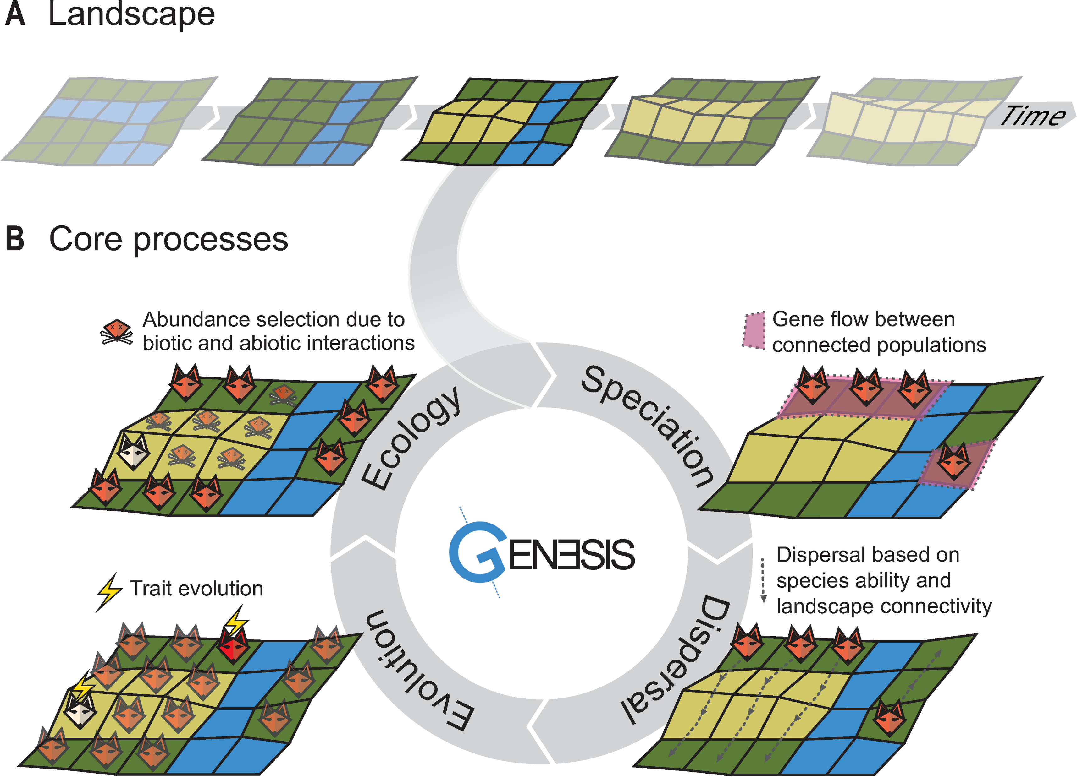
Simulation models (stochastic, mechanistic, process-based)
They have time in them (usually discrete time steps)
Some variables change stochastically (with a given probability)
Often, they are Markov processes, i.e. probability of one event depends on the state in the previous event
Hagen et al. (2021) PLoS Biology

Slide 6
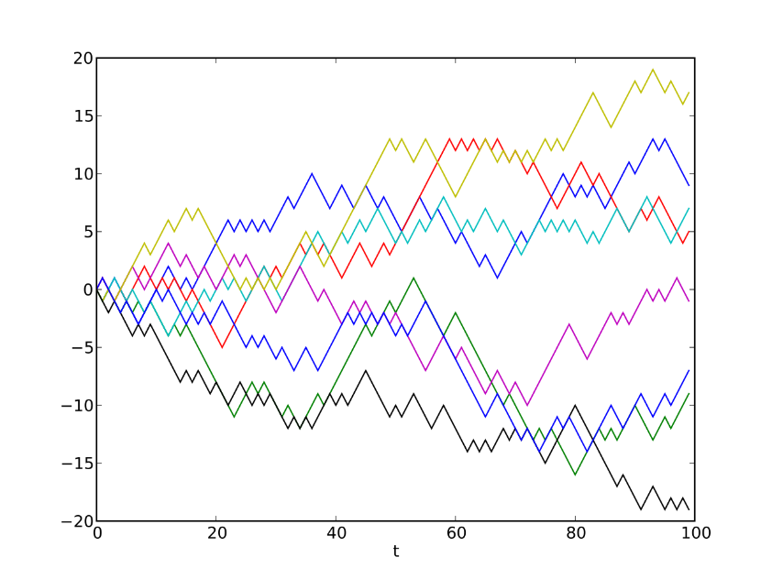
Simplest example of simulation models: The random walk
A random walk, sometimes known as a drunkard's walk, is a random process that describes a path that consists of a succession of random steps on some mathematical space.
An elementary example of a random walk is the random walk which starts at 0, and at each step moves +1 or −1 with equal probability.
Images: Wikimedia Commons
Coding et al. (2008) Random walk models in biology. J. Royal Soc. Interface

Slide 7
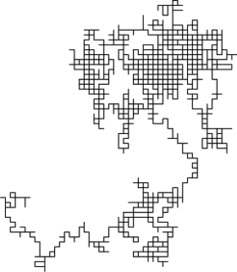
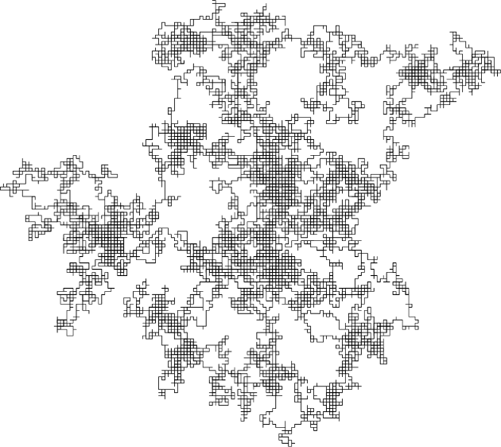
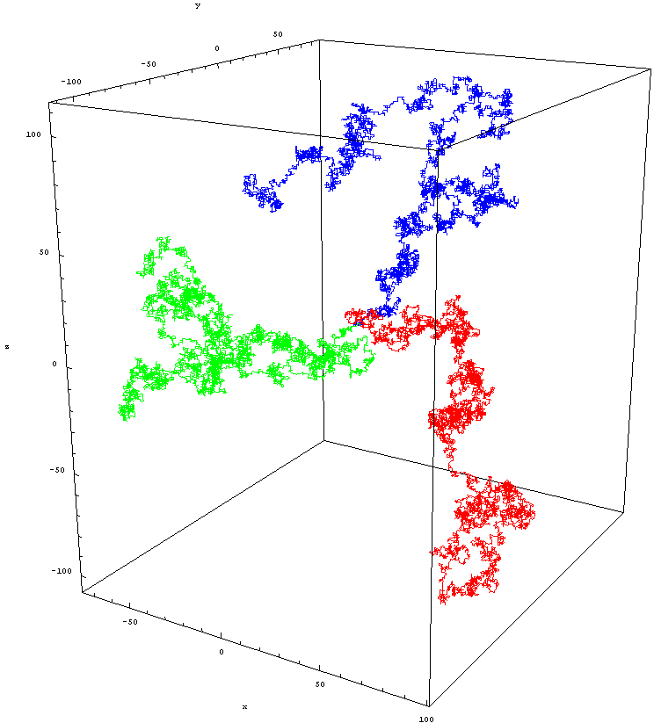
The random walk
Images: Wikimedia Commons

Slide 8
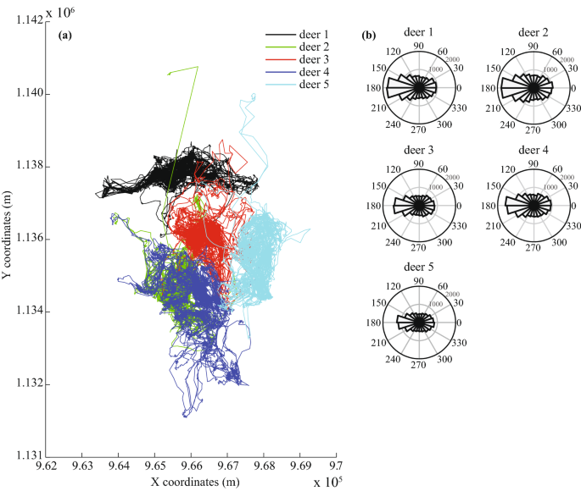
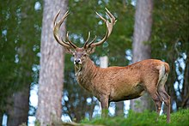
The random walk – a null model for the study of animal movement
Berthelot et al. (2021) Sci. Rep.

Slide 9
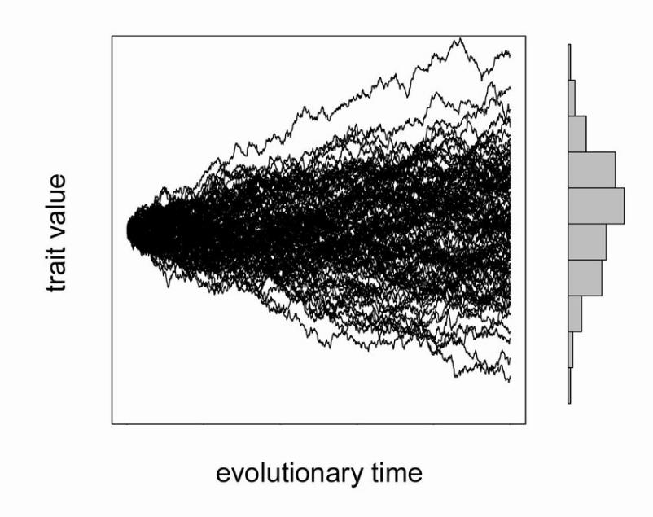
The random walk – a null model for population dynamics or trait evolution

Slide 10
Modelling complex nature with complex models
Agent-based (individual-based) models

Slide 11
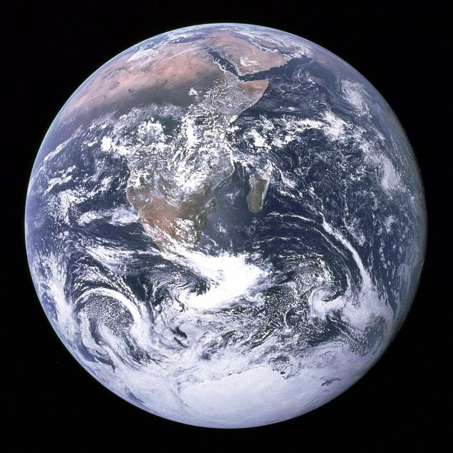
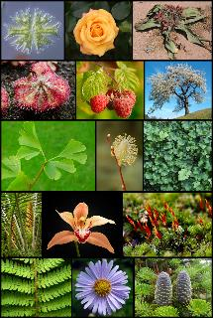
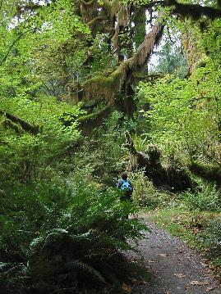
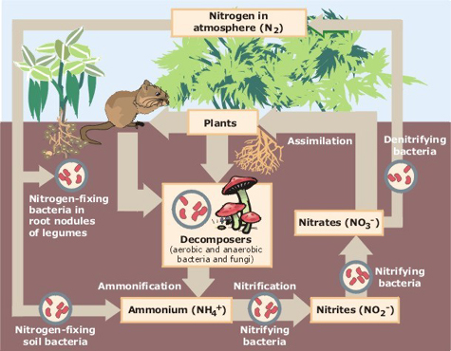
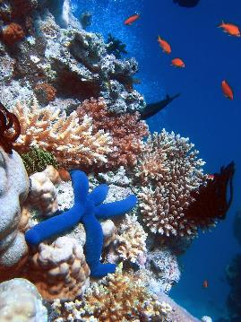
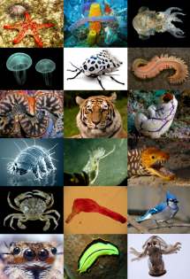
Nature is complex and we can’t always do experiments
Images: Wikimedia Commons

Slide 12
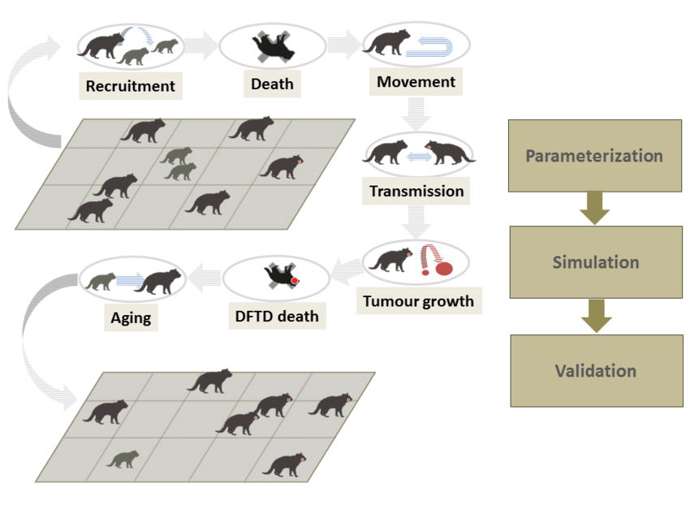
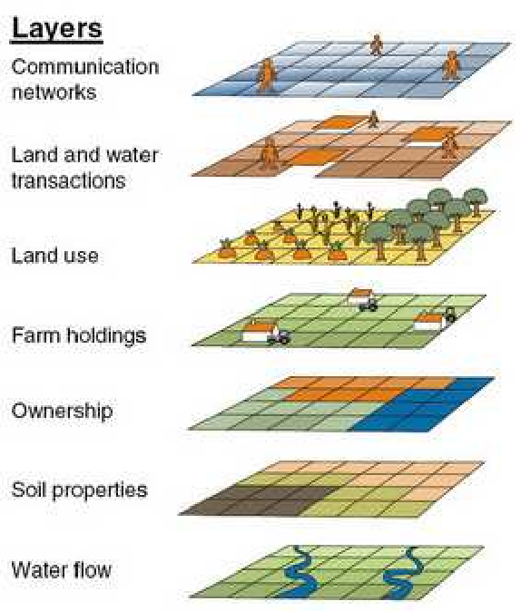
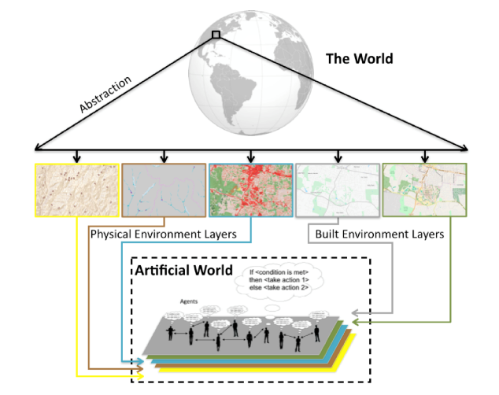

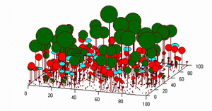

Simulation models: Agent-based models
Agent-based (or individual-based) models are complex models that simulate complex reality. They have high level of detail.
Grimm et al. (2005) Individual-based modelling in ecology

Slide 13
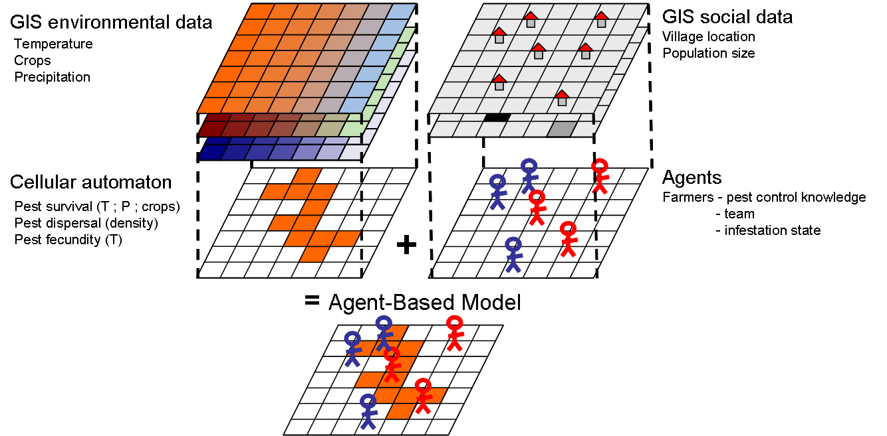
Simulation models: Agent-based models
Agent-based models can combine artificial rules with real-world inputs (e.g. GIS rasters)
Rebaudo et al. (2011) Agent-based modelling of human-induced spread of invasive species in agricultural landscapes. Journal of Artificial Societies and Social Simulation

Slide 14
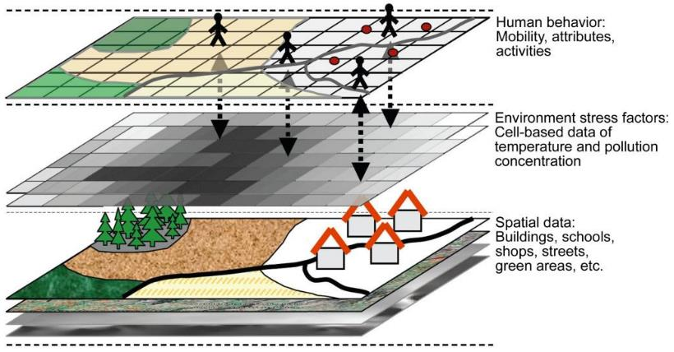
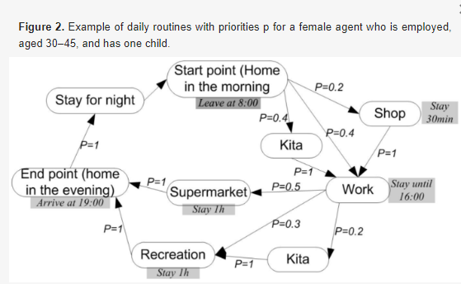
Simulation models: Agent-based models
Agent-based models can combine artificial rules with real-world inputs (e.g. GIS rasters)
human exposure to environmental
Yang et al. (2018) An agent-based modeling framework for simulating human exposure to environmental stresses in urban areas. Urban Science

Slide 15
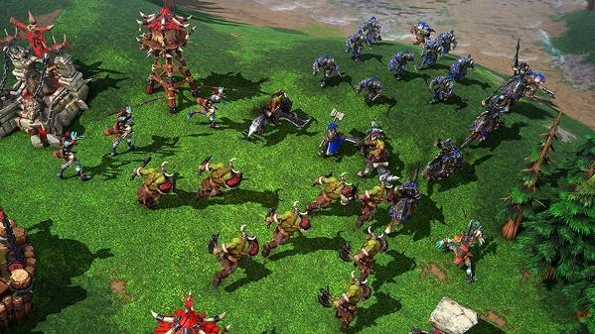
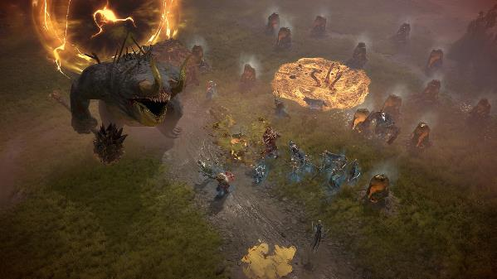

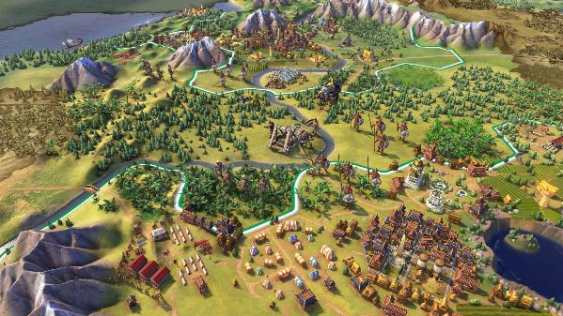
Simulation models: Agent-based models
They seem similar to computer games (agents may have their own intelligence to behave realistically)

Slide 16
Simulation models: Agent-based models
The good:
- We can explore behavior of complex systems that would otherwise be impossible to do experiments with (e.g. human epidemiology, ecology, …)
The bad:
- Too many parameters and agents make it difficult to verify and validate against reality
- The same behavior (pattern) can emerge from all sorts of models
- Many behaviors can emerge from a slight modification of the same model
- Model outputs are difficult to generalize outside of the specific modelling context

Slide 17
From simple rules to simple patterns
Example:

Slide 18
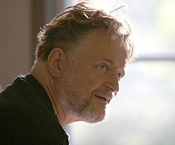
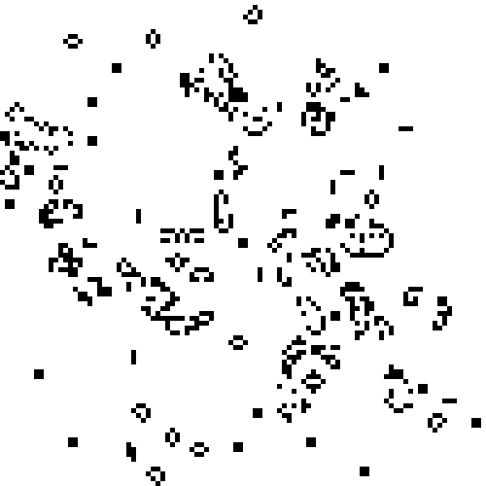
Conway’s Game of Life – simple rules
John Horton Conway
(1937-2020)

Slide 19
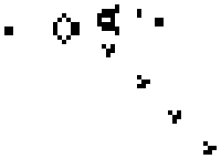
Conway’s Game of Life – simple rules
Any live cell with fewer than two live neighbours dies, as if by underpopulation.
Any live cell with two or three live neighbours lives on to the next generation.
Any live cell with more than three live neighbours dies, as if by overpopulation.
Any dead cell with exactly three live neighbours becomes a live cell, as if by reproduction.

Slide 20
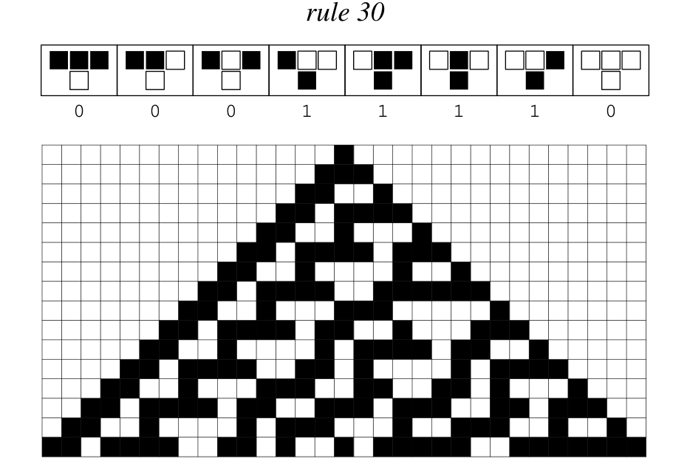
One-dimensional cellular automata
Wolfram MathWorld

Slide 21
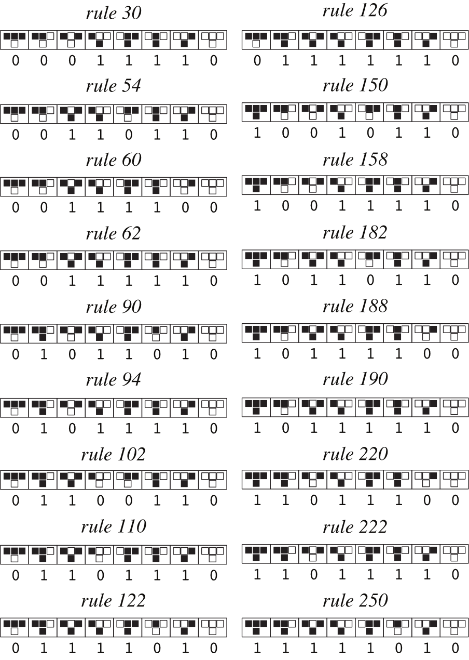
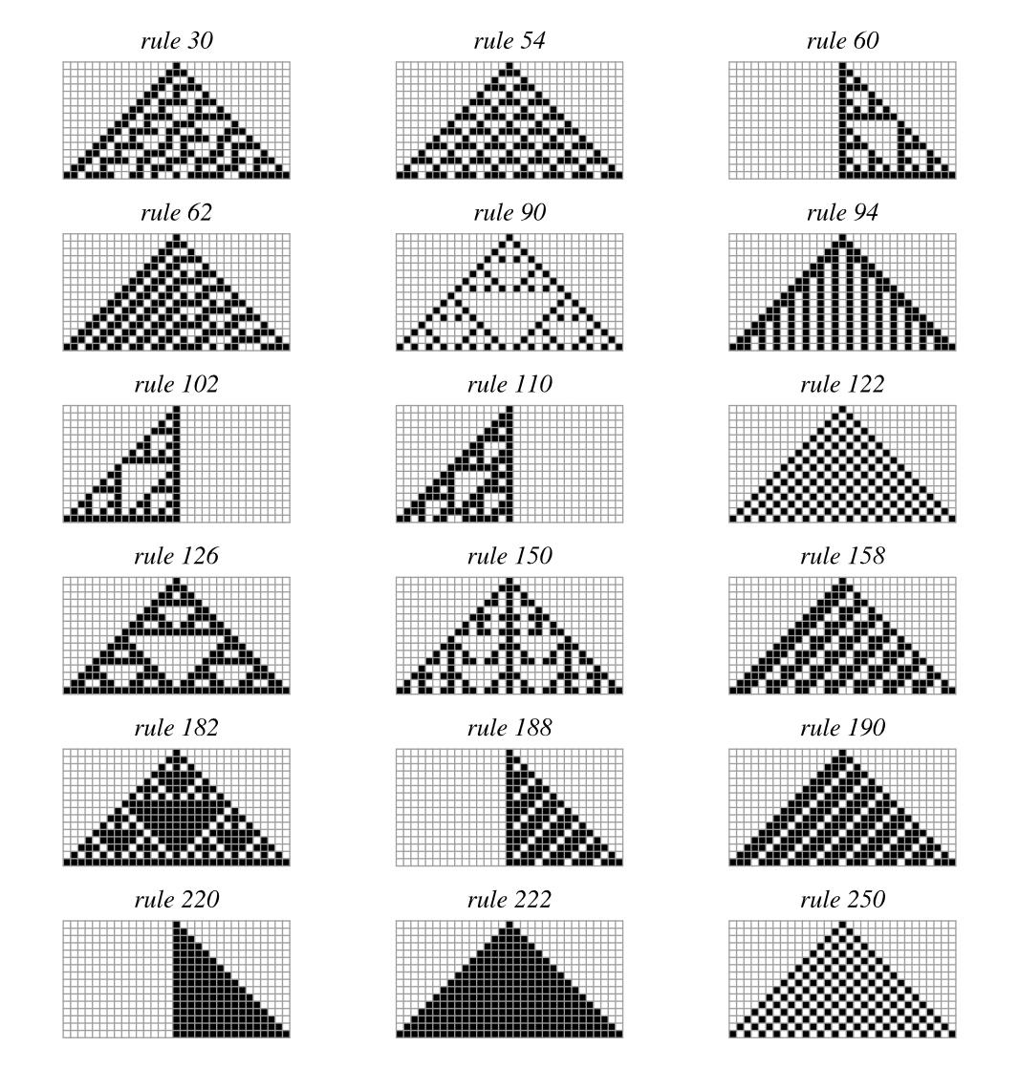
One-dimensional cellular automata
Wolfram MathWorld

Slide 22
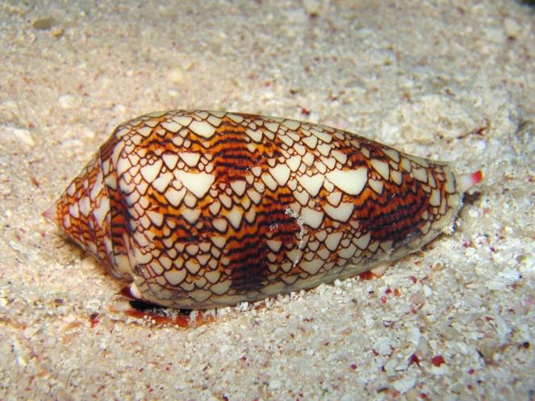
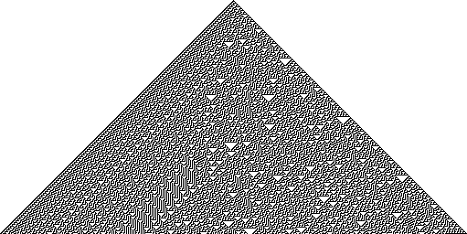
One-dimensional cellular automata
Conus abbas (homolice)
Cellular automaton “rule 30”
Liana Manukyan (1995) Nature

Slide 23
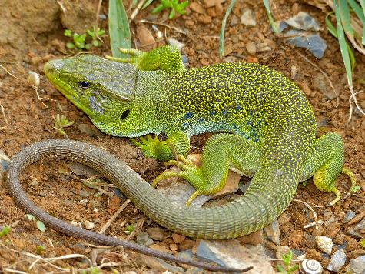
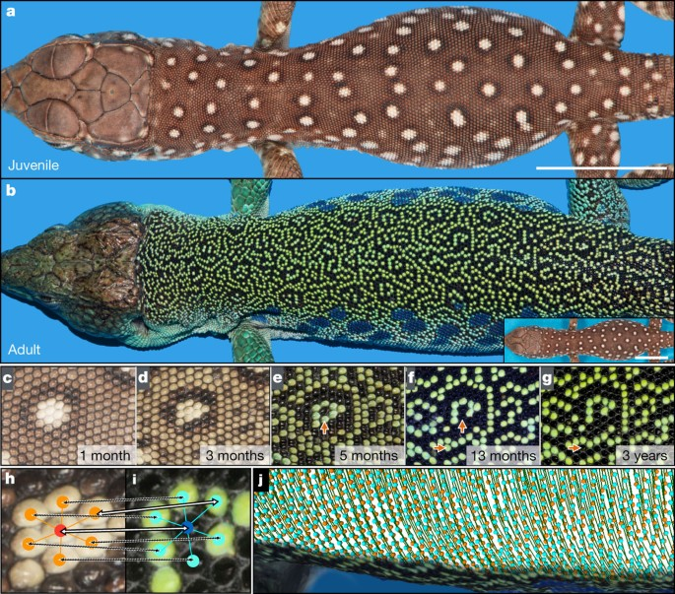
Cellular automata in nature
Manukyan et al. (2017) Nature
Timon lepidus (Ocellated lizard)

Slide 24
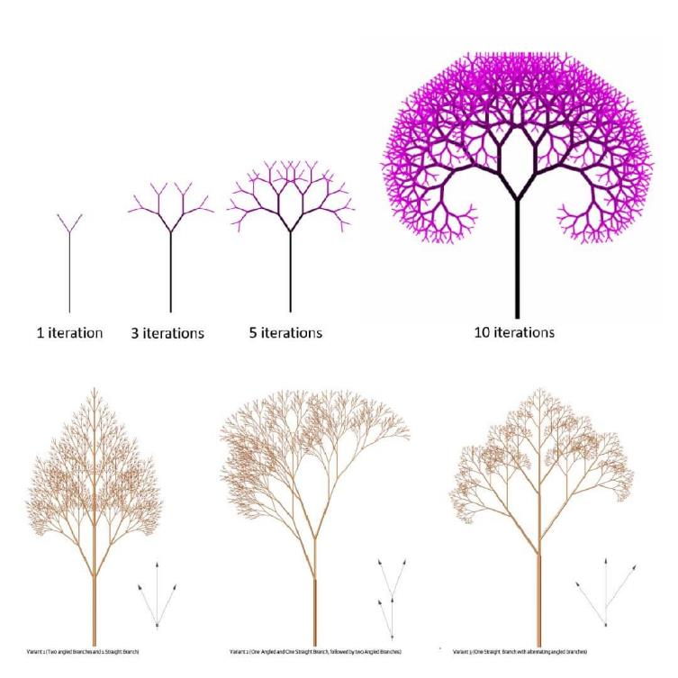
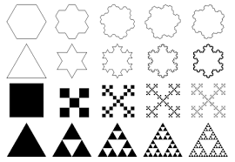
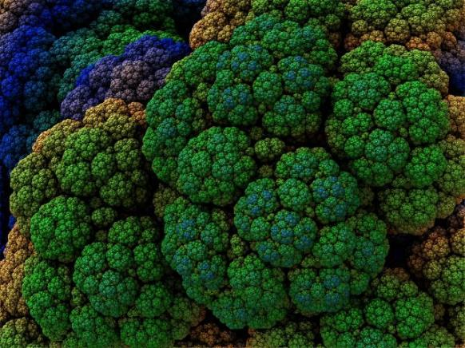
Fractals – another case of simple rules but complex outcomes

Slide 25
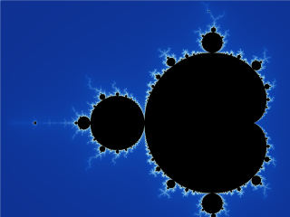
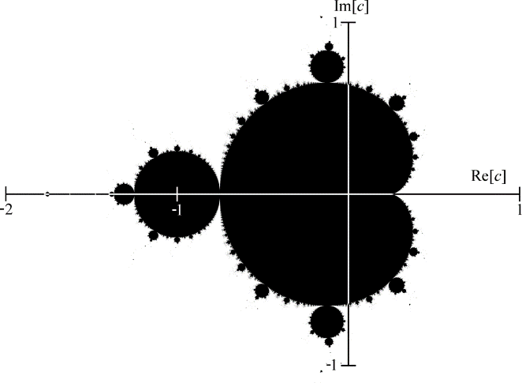
Fractals – another case of simple rules but complex outcomes
Mandelbrot set. Images: Wikimedia Commons

Slide 26
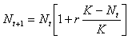
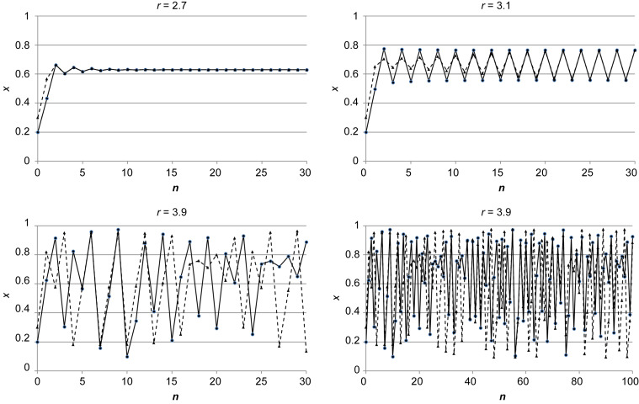
Chaotic behavior of logistic equation – from sigmoidal curve to deterministic chaos
Population size (N)
Time step (t)

Slide 27
What you should know
That complex and seemingly unpredictable (“alive”) structures can emerge from simple rules
What are cellular automata, and give an example of their operation from real world
That fractals and deterministic chaos are examples of complex structures emerging from simple rules
Logistic population model is another example of a model which can produce complex behavior from a simple deterministic equation (rule)

Slide 28
Unified Neutral Theory of Biodiversity
The cellular automaton for community ecology. The simplest model of nature.

Slide 29
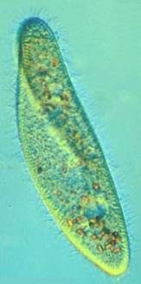
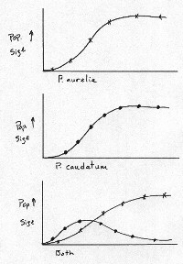
Gause’s principle of competitive exclusion
Two species or populations cannot inhabit the same niche: one will consistently out-compete the other.
When one species has even the slightest advantage over another, the one with the advantage will dominate in the long term.
Complete competitors can not coexist.
So how can species coexist?
Paramecium caudatum
vs. P. aurelia
Gause G. F. (1932) Journal of Experimental Biology

Slide 30
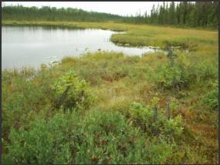
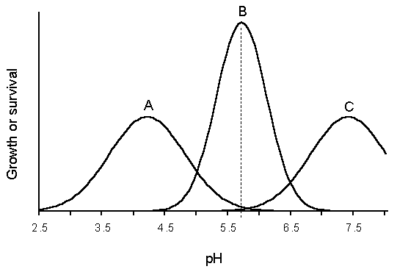
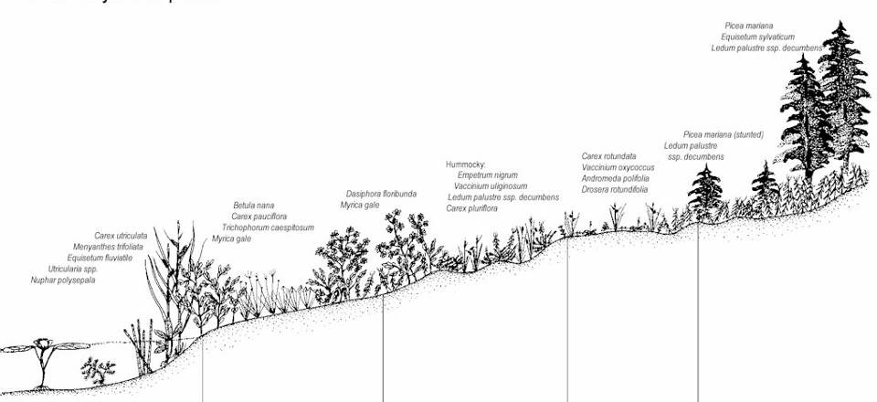
How can species coexist? Thanks to heterogeneity of environment and niche differences
Humididy gradient

Slide 31
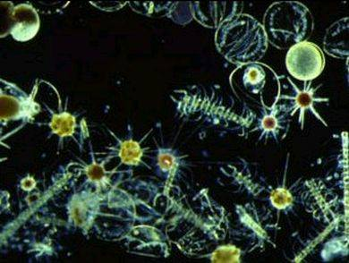
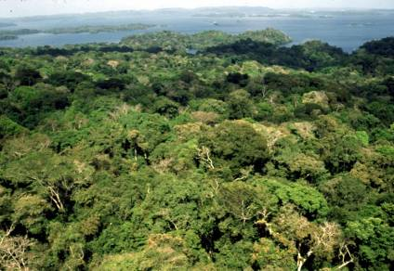
But, there is the paradox of the plankton, tropical forests …
Many species with similar niches coexist in homogeneous environments. How is that possible?
Hutchinson (1961)

Slide 32




Paradox of the plankton, tropical forests
Motoo Kimura
Stephen P. Hubbell
UCLA
Kimura (1983) The neutral theory of molecular evolution
Hubbell (2001) The Unified Neutral Theory of Biodiversity and Biogeography

Slide 33
A neutral model
Metacommunity
Local community

Slide 34
A neutral model
Metacommunity
1. Mortality (disturbance)
Local community

Slide 35
A classic neutral model
Metacommunity
1. Mortality (disturbance)
Local community

Slide 36
A classic neutral model
Metacommunity
1. Mortality (disturbance)
Local community
2. Colonization
(from within the local community, and from other communities)
3. Speciation
(an existing species splits to two)

Slide 37
A classic neutral model
Metacommunity
1. Mortality (disturbance)
Local community
2. Colonization
(from within the local community, and from other communities)
3. Speciation
(an existing species splits to two)

Slide 38
Variants of the neutral model: The spatially explicit neutral model (on infinite landscapes)
Rosindell et al. (2011) Trends in Ecology & Evolution

Slide 39
The neutral model produces realistic patterns (sometimes)
Rosindell et al. (2011) Trends in Ecology & Evolution

Slide 40
What you should know
According to Gause’s principle of competitive exclusion, two species with similar niches should not be able to coexist in a homogeneous environment
Environmental heterogeneity and niche differences enable coexistence
But there is the paradox of the plankton, where similar species coexist in homogeneous environment
The unified neutral theory of biodiversity (UNTB) offers a cellular automaton that resolves the paradox
UNTB sometimes predicts realistic shapes of species-area relationship and species-abundance distributions
UNTB can be seen as a null model, i.e. the most basic expectation which can serve as a baseline for more complex models

Slide 41
The Theory of Island Biogeography
An older and simpler sibling of the Neutral Theory

Slide 42


Two key drivers of biodiversity of islands – area and isolation
MacArthur & Wilson (1967) The Theory of Island Biogeography. Princeton.

Slide 43

Equilibrium of immigration and extinction
MacArthur & Wilson (1967) The Theory of Island Biogeography. Princeton.

Slide 44


The most famous empirical test – defaunation of mangrove islands in Florida
Simberloff & Wilson (1969, 1970) Ecology

Slide 45
What you should know
Large islands and islands nearer to the mainland (source of immigration) have higher equilibrium species richness
This is elegantly formulated in the iconic theory of island biogeography by McArthur and Wilson (1967)
The theory links immigration and colonization to island area and isolation (distance to mainland)
There is a good empirical support for the theory
Islands are everywhere, not just in the sea (e.g. mountain ranges, lakes, patches of habitats) and thus the theory has been highly influential in theoretical and applied ecology (e.g. conservation)
It can be seen as another example of a “null model”, i.e. the most basic expectation which can serve as a baseline for more complex models

Slide 46
What is a null model?
In mathematics, for example in the study of statistical properties of graphs, a null model matches one specific pattern in some of its features, or more generally satisfies a collection of constraints, but which is otherwise taken to be an unbiasedly random structure.
In ecology, null models are usually the simplest models that can be derived from first principles and constraints. They usually contain very little biology.
Null models can serve as a foundation for our understanding of nature. If the null model reproduces the empirically observed patterns, then do we need biology/ecology at all?
They can also be the simplest computational frame (vehicle) on which we can build more complex models.
Random walk and random range placement (the mid-domain effect model) is an example of a simple model that reproduces the hump-shaped pattern of species richness along elevation. The model is also wrong, by the way (Sizling, Storch & Keil 2011, Ecology).

Slide 47
Other null models
Mid-domain effect

Slide 48

The mid-domain effect – example of a pattern that emerges from purely geometrical reasons
The increasing overlap of species ranges towards the centre of a shared geographic domain due to geometric boundary constraints in relation to the distribution of species' range sizes and midpoints.
Colwell & Lees (2000) Trends in Ecology & Evolution

Slide 49

Elevational gradient of species richness
Rahbek (1995) Ecography

Slide 50
Thank you. Questions?

